Slide 1

PMI BELGIUM 2010
NEW YEAR Reception

Slide 2
2010 New Year Reception
PMI BE General Assembly of Members
27 Jan 2010
PDU Code: C133-20100127
Salons de Romrée - Grimbergen

Slide 3











Thank you Sponsors
Notes:
3

Slide 4
Thank You Volunteers
W Gardin, President
Johan Pauwels : Photographer
Dirk Huyers: Web support
Cynthia Grover: Web support
Kris Vunckx: Web support
Maarten Baertsoen: Web support

Slide 5
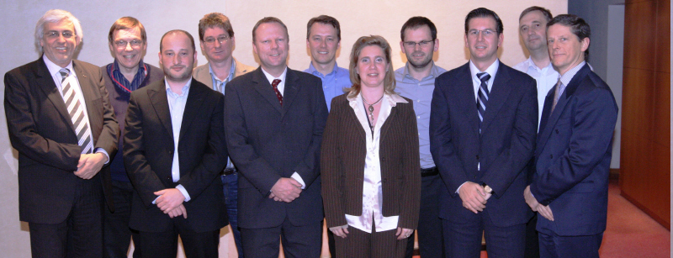
Thank You - Board 2008-2009
W Gardin, President
C Kindermans | A Vandenbergh | P Sarasyn | F Wildemeersch
C Danneels | W Neirinck | S Vandevoorde | W Ducheyne
K Troukens | W Bigare | F Moeris | W Gardin

Slide 6
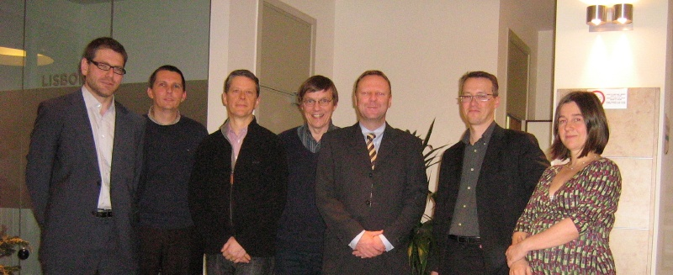
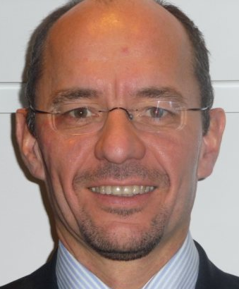
Welcome Board 2010-2011
Wim Gardin, President
Name | Role
Wim Gardin | President
Kris Troukens | Director of Program & Events, Vice President
Wouter Bigaré | Director of Development
Francis Moeris | Director of Sponsorship
Guy Goossens | Director of Finance, Legal & Admin
Kris Jennes | Director of Special Events
Ann Van Herreweghe | Director of Marketing
Daniel Ocsinberg | Director of Membership
Chris Kindermans | Immediate Past President

Slide 7
Mission
Wim Gardin, President
W Gardin, President
Secure and expand the PMI dominant global presence, standards & credentials in the Project Mgt area to the domains of Program & Portfolio Mgt
Focus on sponsor and member needs & concerns by fostering collaborative relationships between PMI members, sponsors and Board of Directors to build bridges of shared knowledge, experience and wisdom across industries
Encourage PMI members to become actively involved and connected with passion and inspiration to increase the PMI member base and membership value

Slide 8
Goals 2010-2011
Wim Gardin, President
W Gardin, President
Stimulate active & organic networking between PMI Members for sustained membership value through
  Feasibility of new event types (eg breakfast meetings)
  Demonstrated pride about new (certified) members
Produce & execute a set of repeatable processes for key PMI deliverables
  Regular events and special events
  Membership (renewal) and sponsorship contracts
Secure a sound financial foundation through expansion of the members (M) and sponsors (S)
  Retention program for M & S
  Active & energetic expansion plan
Customers
Internal
Processes
Finance

Slide 9
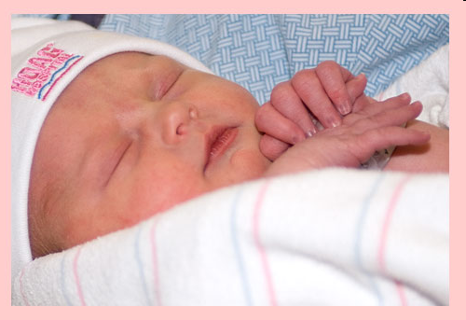
Message from Director of Marketing
Ann Van Herreweghe, Director of Marketing
It s a girl !!!
Welcome Sophie

Slide 10
Message from the Former Director Finance
PMI Belgium - P&L Actuals 2009
Peter Sarasyn:
Category | Expenses | Revenues | Balance | 2008 | 2007
Membership (ME) | 0,00 | 21.584,89 | 21.584,89 | 21.175,00 | 18.955,88
Sponsorship (S) | 0,00 | 3.800,00 | 3.800,00 | 6.700,00 | 8.000,00
Corporate sponsors | 0,00 | 1.000,00 | 1.000,00 | 6.200,00 | not available
Training sponsors | 0,00 | 2.500,00 | 2.500,00 | 500,00 | not available
Job posting sponsors | 0,00 | 300,00 | 300,00 | 0,00 | not available
Events (E) | -26.570,70 | 7.300,00 | -19.270,70 | -4.732,92 | -17.844,81
Chapter meetings / Annual Meeting | -13.882,52 | 3.000,00 | -10.882,52 | -4.275,73 | -5.033,51
Benelux day | -9.226,47 | 4.000,00 | -5.226,47 | 2.273,71 | -3.268,15
OPEN PMI event | -3.461,71 | 300,00 | -3.161,71 | -2.730,90 | -9.543,15
Chapter Developm & Liaison (L) | -98,60 | 0,00 | -98,60 | -5.575,41 | 0
- PM of the Year Award | 0,00 | 0,00 | 0,00 | -5.575,41 | 0
- Other | -98,60 | 0,00 | -98,60 | 0,00 | 0
Professional Development (P) | -121,00 | 0,00 | -121,00 | 0,00 | 0
ISO21500 | -121,00 | 0,00 | -121,00 | 0,00 | 0
Marketing (MA) | -715,12 | 0,00 | -715,12 | -1.259,74 | 0
Back-office Ops (OPS) | -278,30 | 0,00 | -278,30 | -833,36 | 0
Admin (A) | -4.346,21 | 0,00 | -4.346,21 | -5.430,17 | -6.295,98
Donations (D) | 0,00 | 0,00 | 0,00 | -5.000,00 | -6.000,00
- PMI Research Award | 0,00 | 0,00 | 0,00 | -5.000,00 | -5.000,00
- Other | 0,00 | 0,00 | 0,00 | 0,00 | -1.000,00
Banking (B) | -60,16 | 30,89 | -29,27 | 1.941,44 | 1.008,62
Total | -32.190,09 | 32.715,78 | 525,69 | 6.984,84 | -2.176,29
The financial statement information 2009 is prepared and shown for the purpose of our legal general meeting and is reported back to the members only

Slide 11
Message from the Former Director Finance
PMI Belgium - Balance Sheet End 2009
Peter Sarasyn:
As of 31 Dec 2009 (1 € = 1,43 $)
Category | Assets | Liabilities | Balance
Warranty | 500,00
Accounts receivable | 13.955,00
Accounts payable |  | 4.021,58
Provision non-VAT deduction PMI BNLD 2008 |  | 2.440,47
Term account in € | 50.246,74
Term account in $ ($ 1,43) | 3.274,25
Current account Belgium € | 15.354,75
subledger account Luxemburg in € 3.714,41)
Current account in $ ($ 1,43) | 138,46
Total | 83.469,20 | 6.462,05 | 77.007,15
The financial statement information 2009 is prepared and shown for the purpose of our legal general meeting and is reported back to the members only

Slide 12
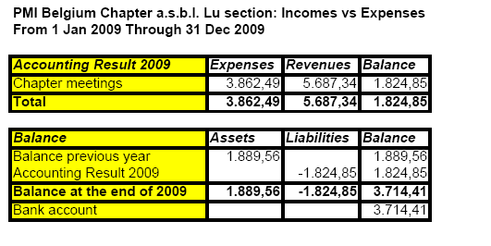
Message from the Former Director Finance
PMI Luxembourg - Actuals 2009
Peter Sarasyn:
The financial statement information 2009 is prepared and shown for the purpose of our legal general meeting and is reported back to the members only

Slide 13
Message from the Director Finance & Legal
Guy Goossens, Director Finance & Legal
My main objectives:
  Act as a Business Controller
  Ensure good & transparent accountancy practices
  Ensure optimal use of the capital & incoming funds
  to ensure added value for our members
  Set-up separate legal Luxembourg Chapter
  Mitigate potential financial risks

Slide 14
Message from the Director Finance & Legal
Guy Goossens, Director Finance & Legal
PMI Belgium – Budget 2010
 |  | Actuals 2007 | Actuals 2008 | Actuals 2009 | Budget 2010 | Variance 09 vs 10
Revenue | Membership fees | 18.955,88 | 21.175,00 | 21.584,89 | 19.170,00 | -11,2%
 | Training/Logo Sponsors | 8.000,00 | 6.700,00 | 3.800,00 | 3.000,00 | -21%
 | Chapter Sponsors | 4.250,00 |  | 3.300,00 | 9.000,00 | 173%
 | Benelux day | 12.390,00 | 2.273,71 | 4.000,00 | 20.000,00 | 400%
 | banking | 1.235,18 | 2.171,44 | 30,89 | 750,00 | 2328,0%
Revenue Total |  | 44.831,06 | 32.320,15 | 32.715,78 | 51.920,00 | 58,7%
Expense | Events | - 18.826,66 | - 12.582,04 | - 17.344,23 | - 15.000,00 | -13,5%
 | Benelux day | - 15.658,15 |  | - 9.226,47 | - 20.000,00 | 116,8%
 | Marketing | - 6.000,00 | - 6.259,74 | - 715,12 | - 1.800,00 | 151,7%
 | Professional Dvlpmt | - |  | - 121,00 | - 1.000,00 | 726,4%
 | Liaison |  |  | - 98,60 | - 2.560,00 | 2496,3%
 | Admin | - 6.295,98 | - 6.263,53 | - 4.624,51 | - 4.950,00 | 7,0%
 | banking | - 226,56 | - 230,00 | - 60,16 | - 81,00 | 34,6%
 | Legal |  |  | - | - 3.050,00
 | Luxemburg |  |  |  | - 3.000,00
Expense Total |  | - 47.007,35 | - 25.335,31 | - 32.190,09 | - 51.441,00 | 59,8%
Net Profit/loss Before Tax |  | - 2.176,29 | 6.984,84 | 525,69 | 479,00 | -8,9%
The financial statement information is prepared and shown for the purpose of our legal general meeting and is reported back to the members only

Slide 15
Message from the Director Finance & Legal
Guy Goossens, Director Finance & Legal
In EUR
The financial statement information is prepared and shown for the purpose of our legal general meeting and is reported back to the members only

Slide 16
Kris Troukens, VP / Director of Programs
Message from the VP/Director of Programs
Calendar 2010 :
  27 JAN New Year Reception
  10 MAR Chapter Event
  05 MAY Chapter Event
  10-12 MAY EMEA Congress in Milan
  23 JUN Chapter Event
  02 OCT 11th BeNeLuxday
  24-25 NOV EVA Conference in Ghent
  01 DEC Open Chapter Event
Notes:
EMEA Congress at the Milano Convention Center
LIM Meeting for Boardmembers, starts 7 MAY

Slide 17
Kris Troukens, VP / Director of Programs
Message from the VP/Director of Programs
2010 :
  Trying out NEW networking methods
    Please Join
  Trying out NEW locations
    Please propose
  Trying out NEW topics
    Please help
  Participate in the Benelux-Day Steering Committee.

Slide 18
Message from the Director of Sponsorship
Francis Moeris, Director of Sponsorships
Thank you very much !
Keep the current formulas
  Chapter Sponsor
  Meeting Sponsor
  Logo Sponsor
  Message in Newsletter
Explore new formulas

Slide 19

Thank you Chapter Sponsors
Francis Moeris, Director of Sponsorships
Notes:
19

Slide 20
Francis Moeris, Director of Sponsorships
Thank you Logo Sponsors
Notes:
20

Slide 21
Message from the Director Professional Development
Wouter Bigare, Director of Professional Development
Representation of Belgium in TC236 and Redaction of ISO 21500 : Project management standard
  Next Milestones ISO/PC 236 for ISO CD 21500
    CD review and ballot: 11 January 2010 – 11 April 2010 (3 months)
    Comments/ballots collated: 12 April 2010 – 12 May 2010 (4 weeks)
    Comments/results circulated: 12 May 2010
    5th Plenary Meeting, Brazil 12 July – 16 July 2010
      CD comments adjudicated
➔ Volunteer opportunity!

Slide 22
Message from the Director Professional Development
Wouter Bigare, Director of Professional Development
Member certification & certification renewal questions
  Congratulations to all PMP, CAPM & PGMP members!
  Pictures later!
Promote PMI within other organisations/confederations
  Do you want to organise a information session in your company? Let us know!
Bring members with certification plans together

Slide 23
Message from the Director of Special Events
Kris Jennes, Director of Special Events
Benelux Day 2010
  October 2
  Location in Belgium (to be determined)
  Concept to be determined
    Volunteers welcome
    Speakers welcome
    Topics welcome
    Sponsors welcome

Slide 24
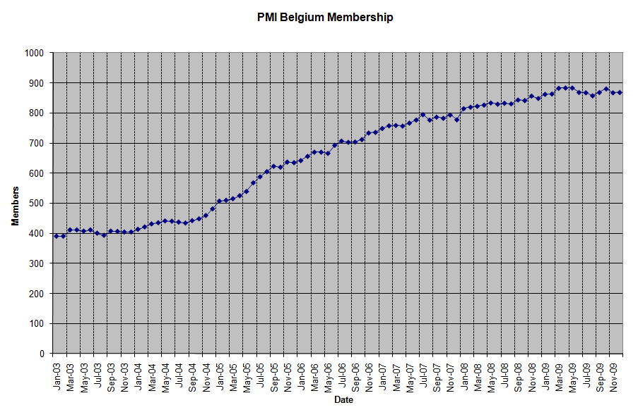
PMI – Belgium in Numbers
Daniel Ocsinberg, Director of Memberships
845 members, of which 516 PMP’s & 24 CAPM’s
100 new members since June 2009
48 new PMPs & 3 new CAPMs since June 2009
Notes:
24

Slide 25
48 new certified PMPs since June 2009
Daniel Ocsinberg, Director of Memberships
Registered for NYR | Not registered for NYR
Bart Criel | Alex Bruyneel Sr. | Joris Valee Sr.
Christiane Borremans | Alexandra Tapia Hompanera | Nadine De Backer
Djaffar Madi Corodji | Antonio Jose Calderon Perez | Peter Alois Judith Van Steenkiste
Eddy Vandenberghe | Bineta Oosterhaven | Philippe Jacquemin
Eva Kovacs | Caroline Scheray | Piet Steven Wauters
Ewa Szczutowska | Didier Carton | Romy Janssens
Frank Westelinck | Dominique Bauduin | Yvan Jean Albert Veldeman
Hans Vanderbeke | Eduard Wijns | Zubeyir Atmaca
Imme Van Der Taelen | Etienne Lejeune | Dagmar Hoeben
Kristof Souwens | Etienne Regnier | Hee Ji Evi Dubois
Nadine Ramaekers | Fabien François | Renuka Ayri
Nathalie Valerie Moedersheim | Filip Anna
Patrick Palmans | Geert Vermeiren
Philip Meyers | Ivo Geers
Ringo Vandenberghe | Jacobus Gerardus van der Kraan
Tom Maria J van Baarle | Jan Van Achter
Ingeborg Buyle | Jan Welvaert
Kristel Demotte | Jean-Louis Piraux
peter van steenkiste | Joachim Vansteelant

Slide 26
3 new certified CAPMs since June 2009
Daniel Ocsinberg, Director of Memberships
Sarah Vangertruijden
Sophie Mathieu
Maarten Bruyneel

Slide 27
100 new PMI-Belgium Members since June 2009
Daniel Ocsinberg, Director of Memberships
Registered for NYR | Not Registered for NYR
Anna Sigurdsson | Alain Cadorette | Filip Cleeren | Jan Ceuleers | Merrenna French
Djaffar Madi Corodji | Alex Bruyneel Sr. | Flavia Greggio | Jean Roose | Mia Monique Bockstal
Francesco Cavallaro | Alexandre Dumortier | FNU leroy | Jean Vos | Michael Dhanens
Houcine Bel Mamoune | Amir GHAFOURI Sr. | FNU Nuyts | Joachim Vansteelant | Michal Rustanowicz
Igor Prozenko | Anne Moreau | FRANCOIS DELEPINE | Johan Hendrickx | Michel Coste
Jef Bauwens | Antonio Perez | Frank G.J. MARQUENIE | johan holsteyns | Michel Lemineur
Marc Mendes Da Costa | Beatrijs Wolters | Gautier Caucheteur | Jussi Tuukkanen | Michel Vandeurzen
Nathalie Moedersheim | Ben Brems | Gautier Touwaide | Koen Vingerhoets | Michiel PELT
Patrick LV Palmans | Ben Kwiecinski | Gema Nogues | Koenraad D'Hondt | Pascal Allouard
Peter A. J. Van Steenkiste | Bertrand BJ Jager | Geoffroy De Puyt | Kousalya Sankaran | Pascal Vanderoost
Peter Vande Kerckhove | Bruno De Winter | Gil Vanden Broeck | Kris Jehaes | Patrick Boivin
Tim Geysen | Caroline Scheray | Guillaume Dewispelaere | Kurt De Koeyer | Philippe Bodart
Tom Maria J van Baarle | Daniel Dricot | Guy JC In 't Ven | Leo Van Peer | Piet Steven Wauters
Valentin Stoica | David Serarols | Hendrik Vermeulen | Maarten Bruyneel | Raymond J Wix
Vincent Duthoit | Dirk DE NIJN | Inge Martens | Mandana Tehrani | Rene Delecaut
Bart Criel | Eddy Vandenberghe | Jacobus van der Kraan | Maria Paola Rojas | Sebastien Theys
Koenraad Beroudiaux | Filiep Degryse | Jacques Ghijselings | Marie-C. CALLEGARI | Sophie Mathieu
 | Wojciech Kasprzykowski | Tim Verfaillie | Stijn Hoegaerts | Stefaan De Vos
 | Xiaodong Guo | Vincent Van Diest | Sumit Kohli | Steven Hunt
 | bruno de regge | Wim Van Daele | Thomas Kemp | Steven Van Dessel
 | Eike Brechlin | Miho Inaoka | Sarah Vangertruijden

Slide 28
Learn-Share-Benefit
Daniel Ocsinberg, Director of Memberships
Increase the Belgian membership and reach 1000 members by the end of 2011
  Contact universities and colleges
  Contact companies
Assist the other directors in their tasks
  Member administration and communication
Get members more involved
  Improve the communication with members
  Obtain higher visibility
  Recognize members’ achievements
Call for volunteers: help PMI-Belgium to reach its goals!
Notes:
28

Slide 29
Thanks to Stephan VandeVoorde previous Director of Programs
PMI Belgium, at the June 2007 event, granted the research collaboration award to Prof. Dr. Vanhoucke Mario.
Today we have a deliverable : a book entitled "Measuring Time: An Earned Value Performance Management Study“

Slide 30
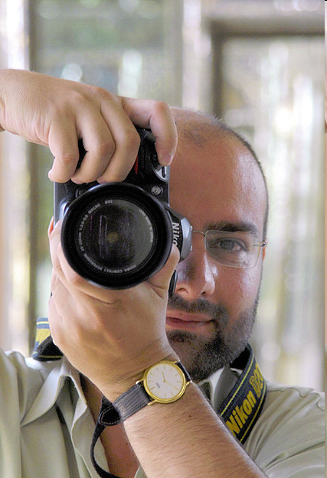
New Members, PMPs, CAPMs – step fwd
Daniel Ocsinberg, Director of Memberships

Slide 31

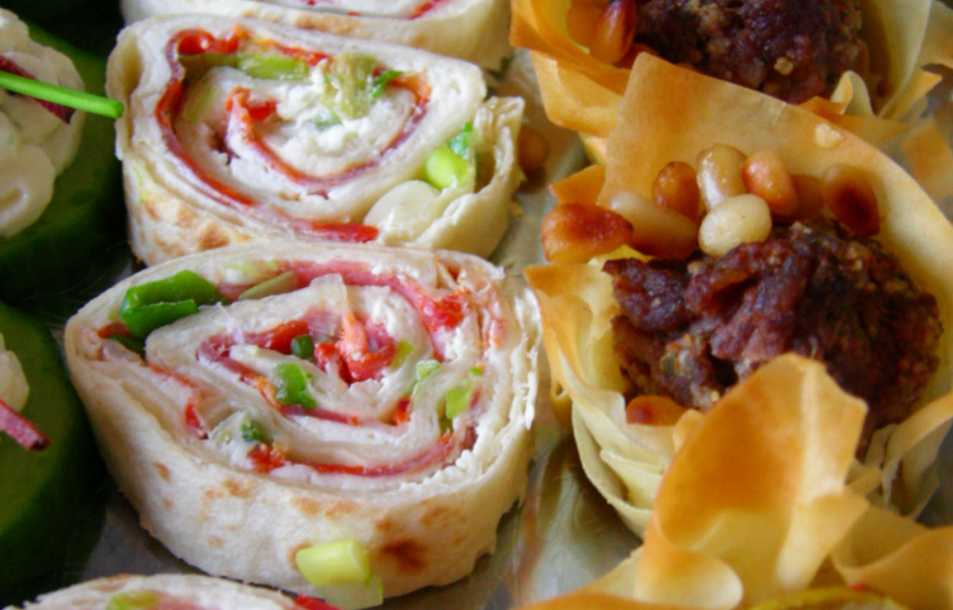
Happy New Year

Slide 32
Thank you Sponsors
Notes:
32

